Slide 1
Business Analyst Internship at PhonePe
Niyati Jain- 189301051
Under the guidance of Dr. Shiladitya Bhattacharjee

Slide 2
Agenda
01. Introduction
02. Motivation
Introducing Problem statement and brief description
Stating the requirement of our project.
03. Methodology
04. Timeline
05. Conclusion
The workflow and chronology of methods are explained.
The timeline of the project is stated with deadlines and Gantt Chart
A concise conclusion along with scope for future works..

Slide 3

Problem Statement
My responsibility with regards to my position as an Analyst at PhonePe includes handling the dataflow, Information Retrieval, Dashboards handling and Coordinating with Stakeholders requirements regarding the Health Insurance products on PhonePe.

Slide 4
Introduction
I will be serving this major project period by gaining industry experience in PhonePe as an analyst intern. The 6-months internship period consists of 1-month of training followed by 5-months of execution that is in line with the job requirement.

Slide 5
About the Company
PhonePe is an Indian digital payments and financial technology company headquartered in Bengaluru, Karnataka, India. It is India’s leading UPI fin-tech Start-up with over 280 million registered users. PhonePe was founded in December 2015, by Sameer Nigam, Rahul Chari and Burzin Engineer. The company allows users to send and receive money, recharge mobile, DTH, data cards, pay at stores, make utility payments, buy gold, and make investments. PhonePe is accepted at over 18 million merchant outlets across 500 cities nationally.
PhonePe went live for customers in August 2016 and was the first non-banking UPI app and offered money transfer to individuals and merchants, recharges and bill payments to begin with. In 2017, PhonePe forayed into financial services with the launch of digital gold, providing users with a safe and convenient option to buy 24-karat gold securely on its platform. PhonePe has since launched Mutual Funds and Insurance products like tax-saving funds, liquid funds, international travel insurance, Corona Care, a dedicated insurance product for the COVID-19 pandemic among others. PhonePe launched its Switch platform in 2018, and today its customers can place orders on over 300 apps including Ola, Myntra, IRCTC, Goibibo, RedBus, Oyo etc. directly from within the PhonePe mobile app.

Slide 6
Motivation
At PhonePe, one gets to build for India’s next billion users, which gives a sense of responsibility.
It is a fast-paced Startup which helps build upon existing skill sets, gain experiences in many functional areas, and take on a ton of real tasks. As the company grows quickly, so does opportunities for career advancement.
Working with the best minds in the industry enables me to learn a lot. Phonepe’s diverse and inclusive corporate culture allows me to showcase as well as hone my existing skills and get better every day.
This Internship really helps boost one’s credentials as they offer professional training modules/courses, expert guidance, and a great working environment throughout the commitment period. The impeccably curated training program helps early onboarding of a fresher candidate and prepares him/her to efficiently find their place and pace the corporate ladder. After serving the limited tenure of the internship period, the company also entitles you to achieving a project and an internship certificate.

Slide 7
Methodology
I perform multiple functions as in charge of analytics concerning PhonePe’s Health Insurance products: Dealing with Stakeholders: One major aspect of my role as an Analyst at PhonePe is to single-handedly deal with the Health Insurance stakeholders to fulfil their asks/updates on relevant data or insights that will help them take judicious product management decisions. I regularly keep in touch with them to provide them useful information/highlights after thorough analysis as well as cater to their requirements that circles around User Profiling and Product Usage. Data Retrieval: To undergo the task of Data extraction, I use SQL to retrieve data from various databases. The real-time data is stored in Foxtrot and other relevant information can be found in the database warehouse (Lucy). I write my SQL queries on Zeppelin notebooks and extract, feed or work with useful data available in these stored databases. Data Analysis and Visualization: This part requires me to analyse data by systematically applying statistical and/or logical techniques to describe and illustrate, condense and recap, and evaluate it. Phonepe has taught us to use various analytical tools and software to perform different analysis and visualization tasks. We use comprehensive software called QlikView and QlikSense to visually represent data in Graphs and maintain dashboards. Along with this, the software aid us in publishing auto-generated email reports and dashboards that are scheduled to published automatically daily through the realtime ingested data. We also use MS-Excel to represent small-scale analysis and manipulations. Data Cleaning and Maintenance: Another essential job responsibility includes cleaning raw datasets (Removing Duplicates, Fix structural errors, Handle missing data, Filter unwanted outliers, etc.) and transforming data i.e. converting data from one format or structure into another. Along with this, I make sure all the necessary data is ingested in Lucy and coordinate with the IT team to understand the data stored to fulfil the necessary tasks analysis.

Slide 8
Feature Extraction
Feature vectors are constructed using various attributes of an image like colour, shape and dimensions to study and detect diseases and henceforth classify them accordingly. It forms the primary step in image Classification model. On exploring the many techniques available for feature extraction, we narrow down our options to the following list of algorithms:
Texture feature extraction: GRAY LEVEL CO-OCCURENCE MATRIX (GLCM) is defined by a matrix which calculates the relation between two pixels at a time. The number of rows and columns in the matrix are equal to the number of grey levels G in an image. The GLCM functions characterize the texture of an image by calculating how often pairs of pixel with specific values and in a specified spatial relationship occur in an image. In GLCM technique, we are focusing on six main features –1. Contrast 2. Dissimilarity 3. Homogeneity 4. Energy 5. Correlation 6. ASM
Color feature extraction: COLOUR SPACING is an conceptual tool for describing the way colours are represented. It can mean the use of a specific colour model or system that turns colours into quantitate or statistical data for analysis. A normal grey scale image can be defined by only one matrix but a colour image is actually composed of three primary and multiple combination colours which can be used for deeper research. We had to discard this method though later on since it wasn’t that feasible to implement for multiple images.

Slide 9
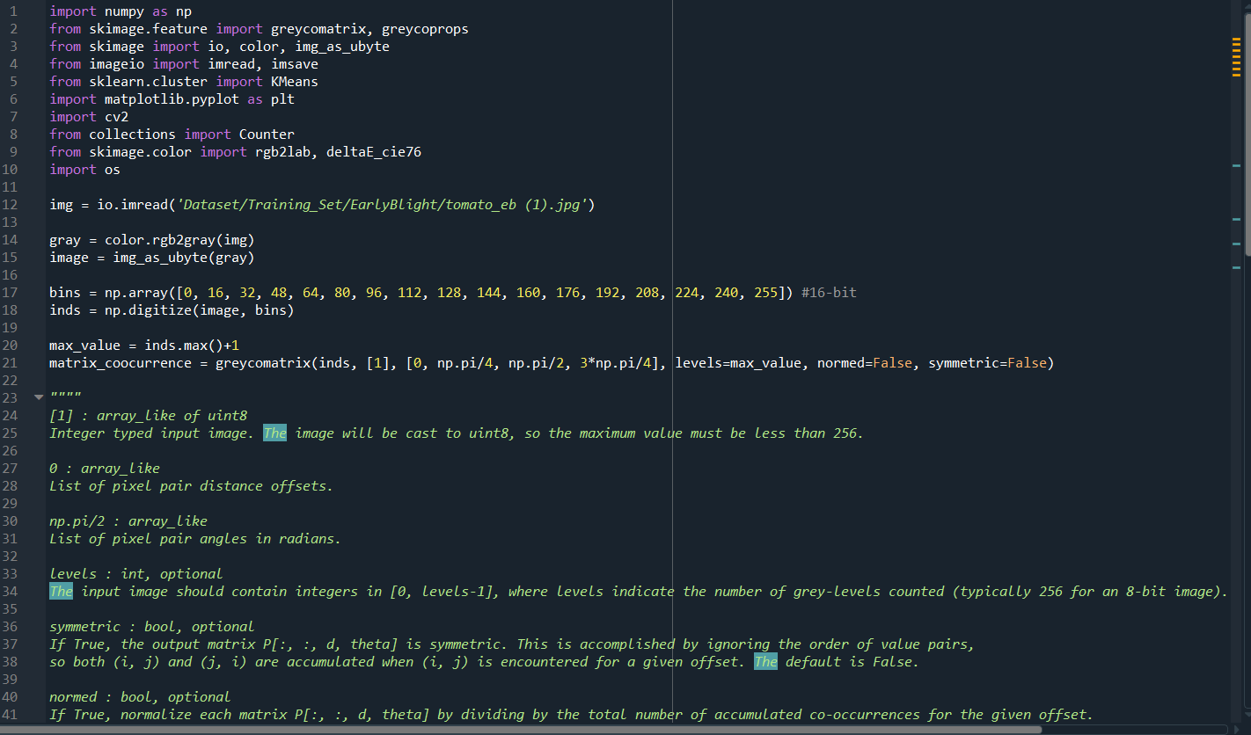
GLCM Code

Slide 10
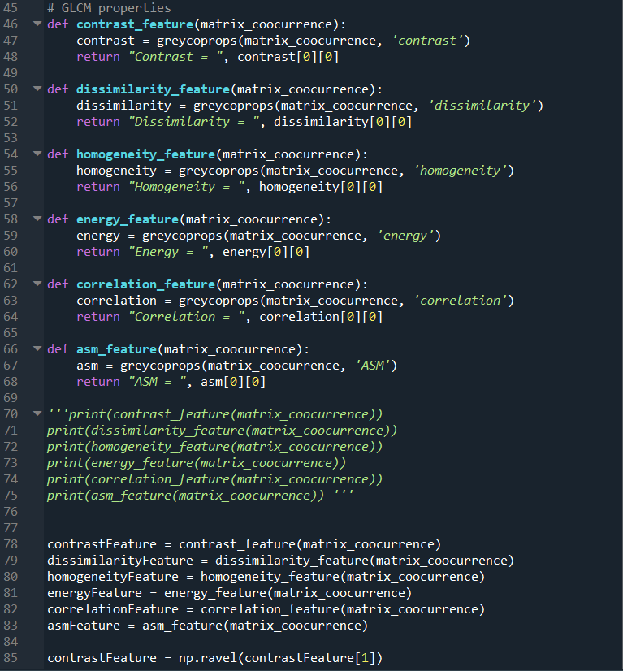

Slide 11
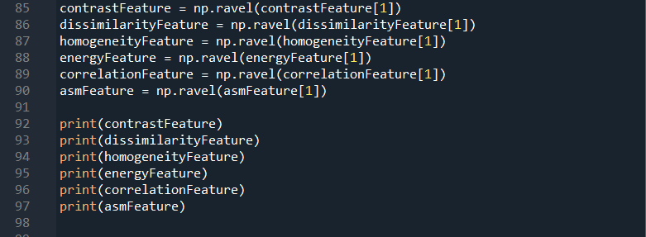

Slide 12
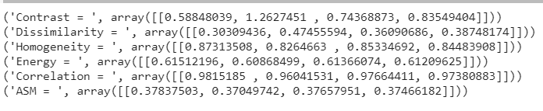
GLCM Output

Slide 13
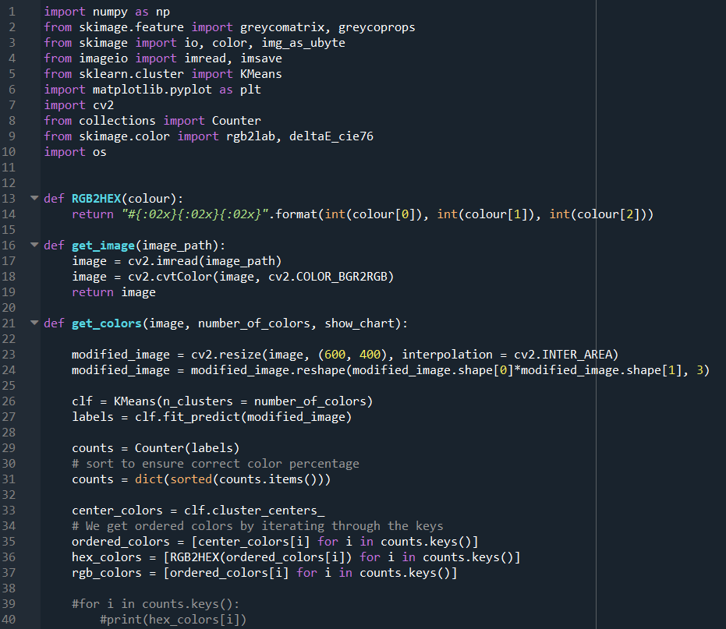
Color Spacing Code

Slide 14
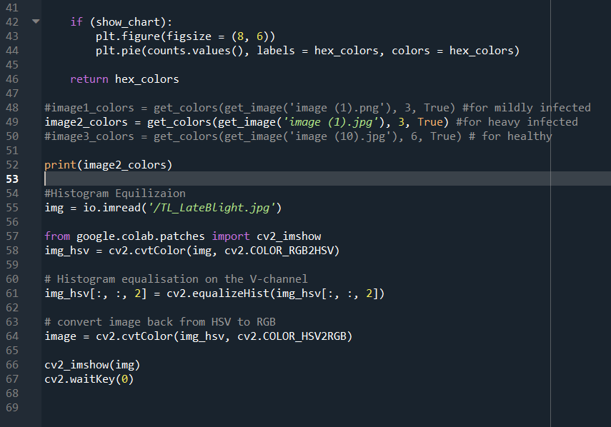

Slide 15
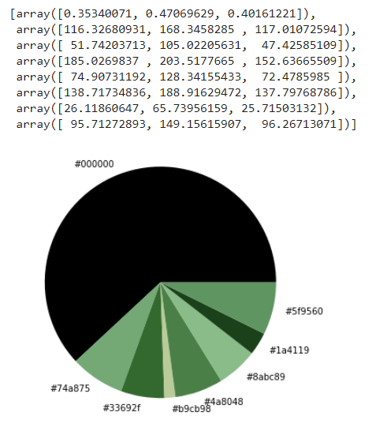
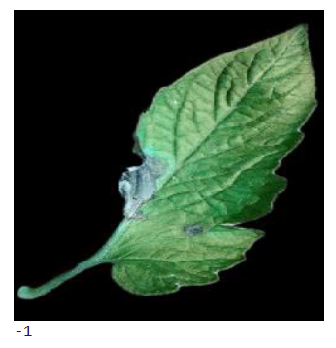
Color Spacing Output

Slide 16
Classification
The last phase determines which disease is present in the leaf using a classification neural network model like CNN, ANN etc.
After extraction of these features, as mentioned in the above sub-section, we decided to store the values of GLCM features and use that as the input for further classification.
We decided to use 6 classification methods as we will have the best accuracy among them, and we can easily compare and tell which method is best for our dataset. These include: SVM, KNN, Kernel SVM, Decision Tree, Naïve Bayes, and Random Forest classification methods for both the classification as mentioned in our problem statement.

Slide 17
1. Healthy vs Infected images
Classifiers | Accuracy | F1 Score | MCC Accuracy
K-Nearest Neighbours(k=2) | 73.33333333333333 % | 77.77777777 % | 50.91750772173156 %
Support Vector Machine(kernel=linear) | 76.6666 % | 75.0 % | 53.813823519705 %
Support Vector Machine(kernel=rbf) | 80.0 % | 76.92307692307693 % | 62.25430174794672 %
Support Vector Machine(kernel=sigmoid) | 65.0 % | 66.66666666666666 % | 30.15113445777636 %
Random Forest(n_estimators=5) | 75.0 % | 72.72727272727273 % | 50.709255283710995 %
Naïve Bayes | 76.66666666666666 % | 73.07692307692307 % | 55.337157109285975 %
Decision Tree | 65.0 % | 63.1578947368421 % | 30.15113445777636 %

Slide 18
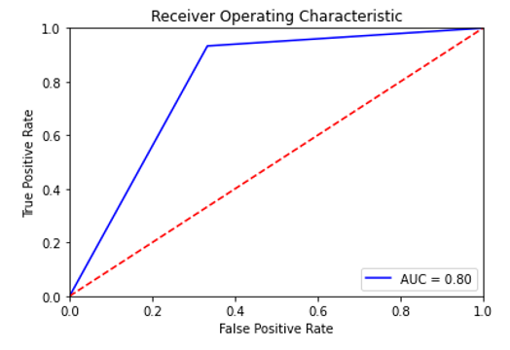
Results for Classification of Healthy vs Infected images
We created a dataset of 140 images in the Training set and 60 images in the Test set.
After trying our hands on the six classification methods, we finally achieved the best accuracy, i.e 80.0% from Support Vector Machine with kernel set as RBF(Radial Basis Function).
Accuracy: 80.0 %
F1 measure: 76.92307692307693 %
MCC Accuracy: 62.25430174794672 %

Slide 19
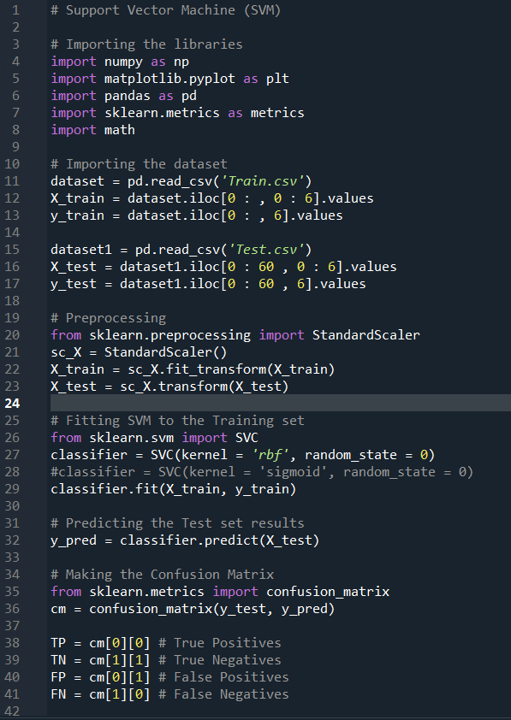
SVM Kernel=rbf Code

Slide 20
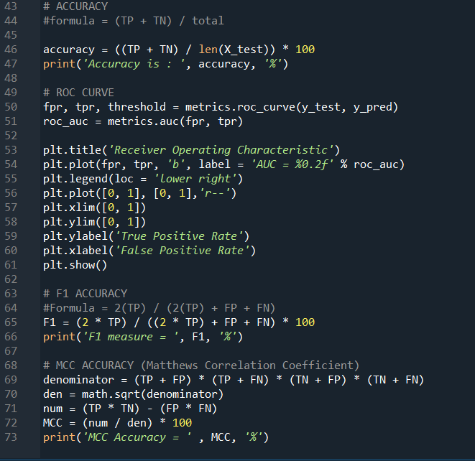

Slide 21
2. Early vs Late Blight images
Classifiers | Accuracy | F1 Score | MCC Accuracy
K-Nearest Neighbours(k=3) | 81.66666666666667 % | 83.5820895522388 % | 65.1311611681508 %
Support Vector Machine(kernel=linear) | 78.33333333333333 % | 79.36507936507937 % | 56.95214286468868 %
Support Vector Machine(kernel=rbf) | 76.66666666666667 % | 78.78787878787878 % | 54.433105395181734 %
Support Vector Machine(kernel=sigmoid) | 55.00000000000001 % | 54.23728813559322 % | 10.005560189476052 %
Random Forest(n_estimators=5) | 75.0 % | 77.61194029850746 % | 51.419337764329576 %
Naïve Bayes | 65.0 % | 68.65671641791045 % | 30.85160265859774 %
Decision Tree | 65.0 % | 67.6923076923077 % | 30.425553170226593 %

Slide 22
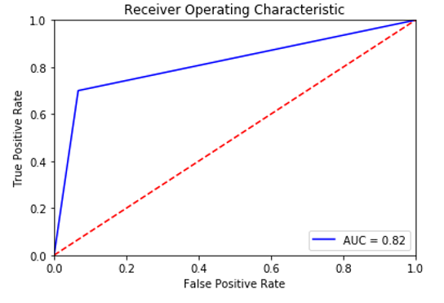
Results for Classification of Early Blight vs Late Blight images
We created a dataset of 140 images in the Training set and 60 images in the Test set.
After trying our hands on the six classification methods, we finally achieved the best accuracy, i.e 81.66% from KNN(K-Nearest Neighbours) with k value set to 3.
Accuracy: 81.66666666666667 %
F1 measure: 83.5820895522388 %
MCC Accuracy: 65.1311611681508 %

Slide 23
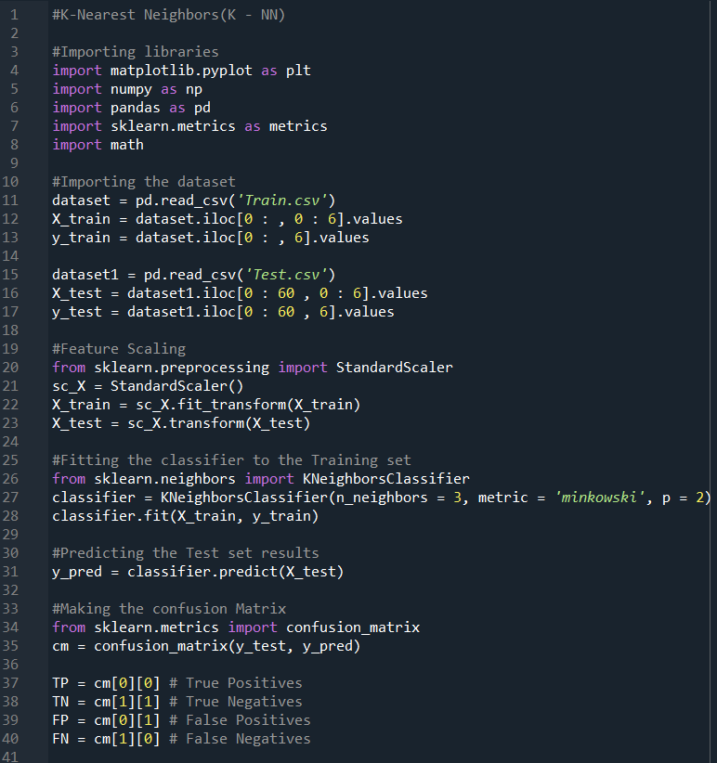
KNN Code with k=3

Slide 24
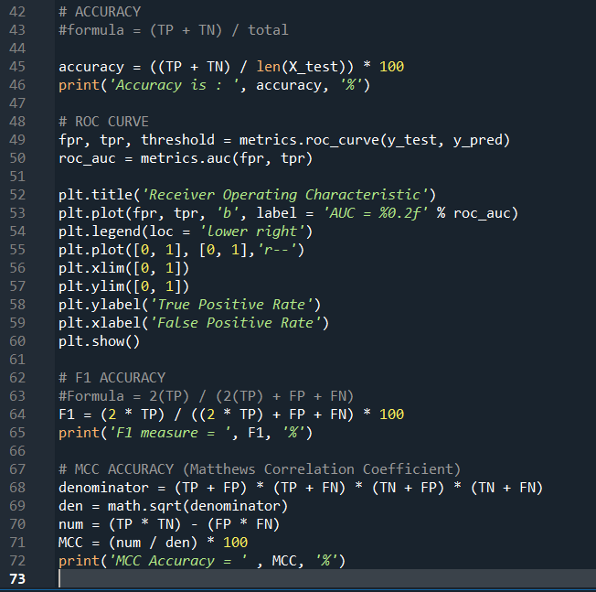

Slide 25
Timeline
15th Feb- 15th March
16th April-15th May
DATASET PREPARATION, ACQUISITION AND ANALYSIS.
CLASSIFICATION MODEL.
16th March-15th April
16th May-31st May
PRE-PROCESSING, SEGMENTATION AND FEATURE EXTRACTION.
ANALYSIS OF RESULT.

Slide 26
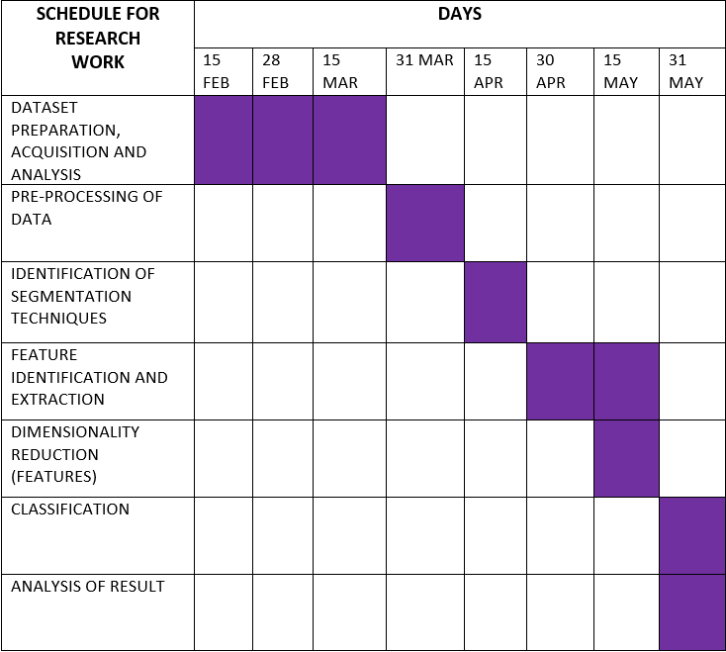
Gantt Chart

Slide 27
Conclusion and Future Plan
All these approaches are based on Machine Learning and Computer Vision to build a classifier of diseases using the image of just the leaf, which signifies the leap in technology that the world has taken and realising that people in remote areas will also be able to be a part of this endeavour motivates a lot of computer scientists. Through this classifier, farmers will be able to identify the problem in an earlier stage, thus increasing the production and decreasing the later financial risks.

